Slide 1
Do czego służą sagi i w czym może nam pomóc event sourcing
Damian Sińczak

Slide 2
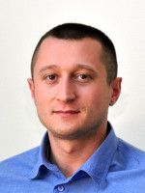


O mnie
Damian Sińczak
Obecnie: Scala Developer w IDEMIA (wcześniej Oberthur)
dsinczak
dsinczak

Slide 3
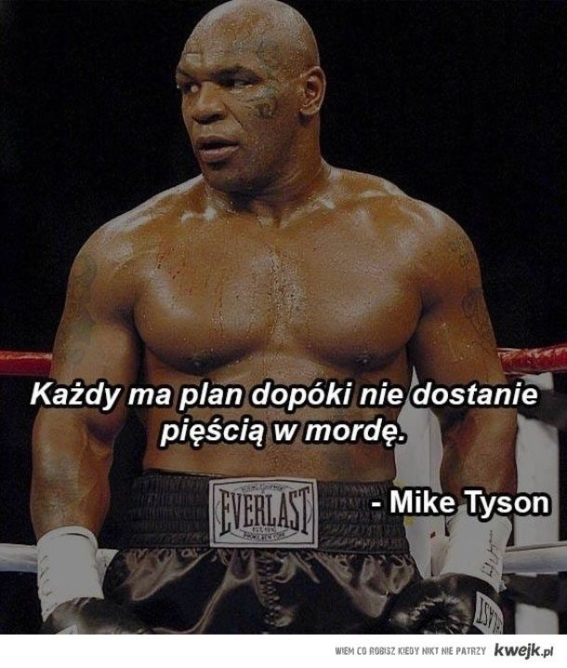
Małe przeprosiny

Slide 4

Małe przeprosiny
Zawodnik okazał się za mocny…
Ale będzie rewanż!

Slide 5
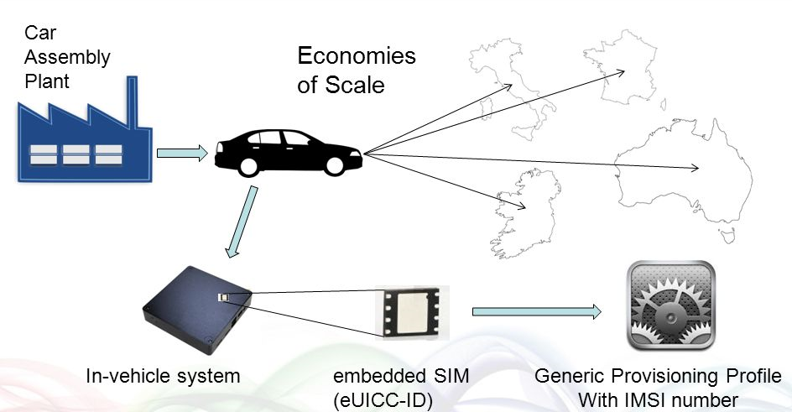
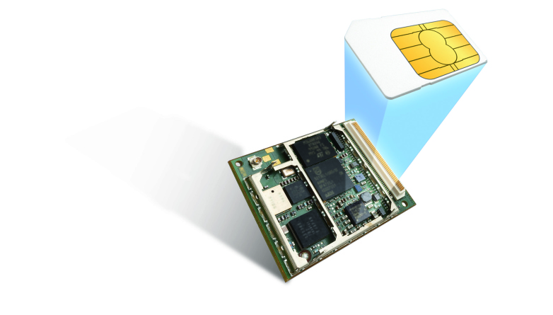

Czym się zajmuję (przyda się do opisu problemu)
Remote SIM provisioning for M2M
https://www.gsma.com/iot/embedded-sim/

Slide 6
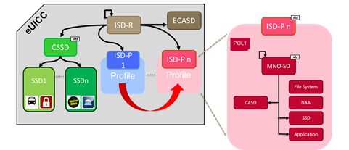
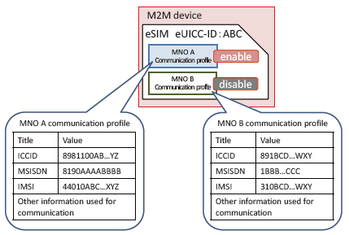
Jak wygląda eUICC

Slide 7
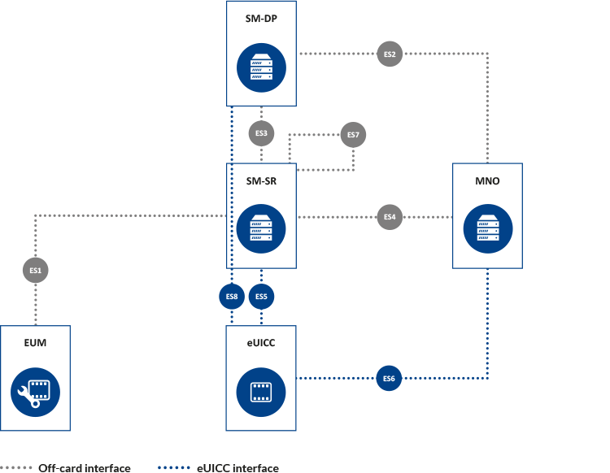
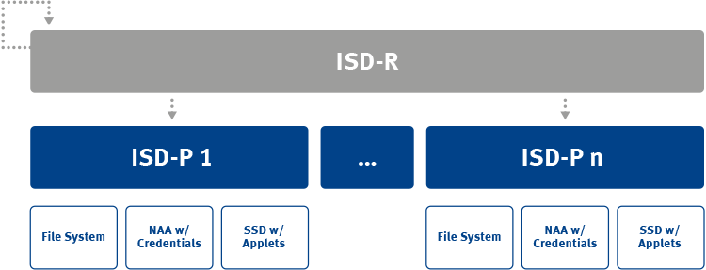
Komunikacja z kartą

Slide 8

Płyń do brzegu
eUICC
The others…
SM-SR
SM-SR

Slide 9
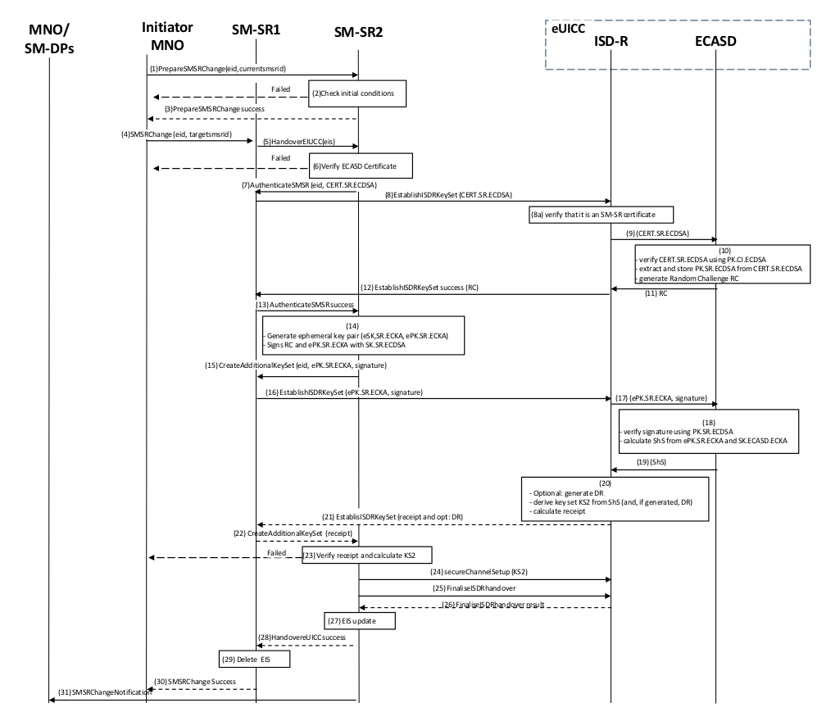
Nie trudne… ale nie trywialne

Slide 10
Krok po kroku
Odbiorca
EID, SMSR ID
Validity Period
PrepareSMSRChange
(EID, currentSmsrId)
SM-SR
EUICC
MNO
Dostawca
SM-SR

Slide 11
Krok po kroku
Odbiorca
EID, SMSR ID
Validity Period
SM-SR
EUICC
MNO
Dostawca
X
EID, SMSR ID
Validity Period
No response
SM-SR
X
SMSRChange
(EID, targetSmsrId)

Slide 12
Krok po kroku
Odbiorca
EID, SMSR ID
Validity Period
EIS
SM-SR
EUICC
MNO
X
HandoverEUICC
(EIS[eid, isdr, ecasd,…])
Dostawca
EID, SMSR ID
Validity Period
SM-SR

Slide 13
Krok po kroku
Odbiorca
EID, SMSR ID
Validity Period
EIS
SM-SR
EUICC
MNO
AuthenticateSMSR
(EID, CERT.SR.ECDSA)
Dostawca
EID, SMSR ID
Validity Period
CERT.SR.ECDSA
SM-SR

Slide 14
Krok po kroku
Odbiorca
EID, SMSR ID
Validity Period
EIS
SM-SR
EUICC
PK.SR.ECDSA
Random Challenge
MNO
EstablishISDRKeySet
(CERT.SR.ECDSA)
Dostawca
EID, SMSR ID
Validity Period
CERT.SR.ECDSA
Random Challenge
Response
(Random Challendge)
SM-SR

Slide 15
Krok po kroku
Odbiorca
EID, SMSR ID
Validity Period
EIS
Random Challenge
SM-SR
EUICC
PK.SR.ECDSA
Random Challenge
MNO
AuthenticateSMSRResponse
(Random Challenge)
Dostawca
EID, SMSR ID
Validity Period
CERT.SR.ECDSA
Random Challenge
Notice no EID
SM-SR

Slide 16
Krok po kroku
Random Challenge
+ Magic dust
eSK.SR.ECKA -> ePK.SR.ECKA
Odbiorca
EID, SMSR ID
Validity Period
EIS
Random Challenge
SM-SR
Signature
ePK.SR.ECKA
Shared Secret
ePK.SR.ECKA
Signature
Shared Secret
EUICC
PK.SR.ECDSA
Random Challenge
MNO
Dostawca
EID, SMSR ID
Validity Period
CERT.SR.ECDSA
Random Challenge
SM-SR

Slide 17
Krok po kroku
eSK.SR.ECKA -> ePK.SR.ECKA
Odbiorca
EID, SMSR ID
Validity Period
EIS
Random Challenge
SM-SR
Signature
ePK.SR.ECKA
Shared Secret
EUICC
PK.SR.ECDSA
Random Challenge
MNO
CreateAdditionalKeySet
(EID, ePK.SR.ECKA, Signature)
Dostawca
EID, SMSR ID
Validity Period
CERT.SR.ECDSA
Random Challenge
SM-SR
ePK.SR.ECKA, Signature

Slide 18
Krok po kroku
eSK.SR.ECKA -> ePK.SR.ECKA
Odbiorca
EID, SMSR ID
Validity Period
EIS
Random Challenge
SM-SR
Signature
ePK.SR.ECKA
Shared Secret
EUICC
PK.SR.ECDSA
Random Challenge
ePK.SR.ECKA
Shared Secret
MNO
EstablishISDRKeySet
(ePK.SR.ECKA, Signature)
Dostawca
Derivation Random
Derived KeySet
Receipt
EID, SMSR ID
Validity Period
CERT.SR.ECDSA
Random Challenge
Response
(Receipt, Derivation Random)
SM-SR
ePK.SR.ECKA, Signature
Receipt
Derivation Random

Slide 19
Krok po kroku
eSK.SR.ECKA -> ePK.SR.ECKA
Odbiorca
EID, SMSR ID
Validity Period
EIS
Random Challenge
SM-SR
Signature
ePK.SR.ECKA
Shared Secret
Derivation Random
Receipt
EUICC
PK.SR.ECDSA
Random Challenge
ePK.SR.ECKA
Shared Secret
MNO
CreateAdditionalKeySetResponse
(Derivation Random, Receipt)
Dostawca
Derivation Random
Derived KeySet
Receipt
EID, SMSR ID
Validity Period
CERT.SR.ECDSA
Random Challenge
Notice no EID
SM-SR
ePK.SR.ECKA, Signature
Receipt
Derivation Random

Slide 20
Krok po kroku
Shared Secret
+ Derivation Random
+ Magic Dust
eSK.SR.ECKA -> ePK.SR.ECKA
Odbiorca
EID, SMSR ID
Validity Period
EIS
Random Challenge
SM-SR
Signature
ePK.SR.ECKA
Shared Secret
Derivation Random
Receipt
Derived KeySet
Receipt
+ KeySet
EUICC
PK.SR.ECDSA
Random Challenge
ePK.SR.ECKA
Shared Secret
MNO
Dostawca
Derivation Random
Derived KeySet
Receipt
EID, SMSR ID
Validity Period
CERT.SR.ECDSA
Random Challenge
SM-SR
ePK.SR.ECKA, Signature
Receipt
Derivation Random

Slide 21
Krok po kroku
Odbiorca
EID, SMSR ID
Validity Period
EIS
Random Challenge
1) Secure channel with KeySet
SM-SR
Signature
ePK.SR.ECKA
Shared Secret
Derivation Random
Receipt
Derived KeySet
2) FinalizeISDRHandover
Delete old keys
Update HTTP security
Update HTTP connectivity
Update SMS connectivity
EUICC
PK.SR.ECDSA
Random Challenge
ePK.SR.ECKA
Shared Secret
MNO
Dostawca
Derivation Random
Derived KeySet
Receipt
EID, SMSR ID
Validity Period
CERT.SR.ECDSA
Random Challenge
Response
SM-SR
ePK.SR.ECKA, Signature
Receipt
Derivation Random

Slide 22
Krok po kroku
Odbiorca
EID, SMSR ID
Validity Period
EIS
Random Challenge
SM-SR
Signature
ePK.SR.ECKA
Shared Secret
Derivation Random
Receipt
Derived KeySet
EUICC
PK.SR.ECDSA
Random Challenge
ePK.SR.ECKA
Shared Secret
MNO
HandoverEUICCResponse
Dostawca
Derivation Random
Derived KeySet
Receipt
EID, SMSR ID
Validity Period
CERT.SR.ECDSA
Random Challenge
Notice no EID
SM-SR
ePK.SR.ECKA, Signature
Receipt
Derivation Random

Slide 23
Krok po kroku
Odbiorca
EID, SMSR ID
Validity Period
EIS
Random Challenge
SM-SR
Signature
ePK.SR.ECKA
Shared Secret
Derivation Random
Receipt
Derived KeySet
EUICC
PK.SR.ECDSA
Random Challenge
ePK.SR.ECKA
Shared Secret
MNO
Dostawca
Derivation Random
Derived KeySet
Receipt
EID, SMSR ID
Validity Period
CERT.SR.ECDSA
Random Challenge
SM-SR
ePK.SR.ECKA, Signature
Receipt
Derivation Random
SMSRChangeResponse

Slide 24

Pytanie do publiczności
Jak nazywa się algorytm generowania kluczy przedstawiony w procesie?

Slide 25
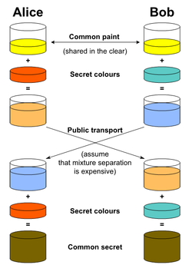
Podpowiedź

Slide 26
Jak taki proces zaimplementować?

Slide 27

Klasyk
Endpoint
Controller
Service
Dao

Slide 28
Klasyk
Endpoint
Controller
Service
Dao

Slide 29
Klasyk
Endpoint
Controller
Service
Dao
Endpoint
Controller
Service
Dao
Endpoint
Controller
Service
Dao
Endpoint
Controller
Service
Dao

Slide 30
Klasyk
Endpoint
Controller
Service
Dao
Endpoint
Controller
Service
Dao
Endpoint
Controller
Service
Dao
Endpoint
Controller
Service
Dao

Slide 31
Klasyk
Endpoint
Controller
Service
Dao
Endpoint
Controller
Service
Dao
Endpoint
Controller
Service
Dao
Endpoint
Controller
Service
Dao

Slide 32
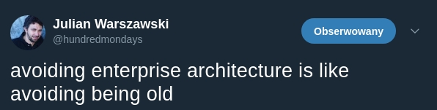
Klasyk

Slide 33
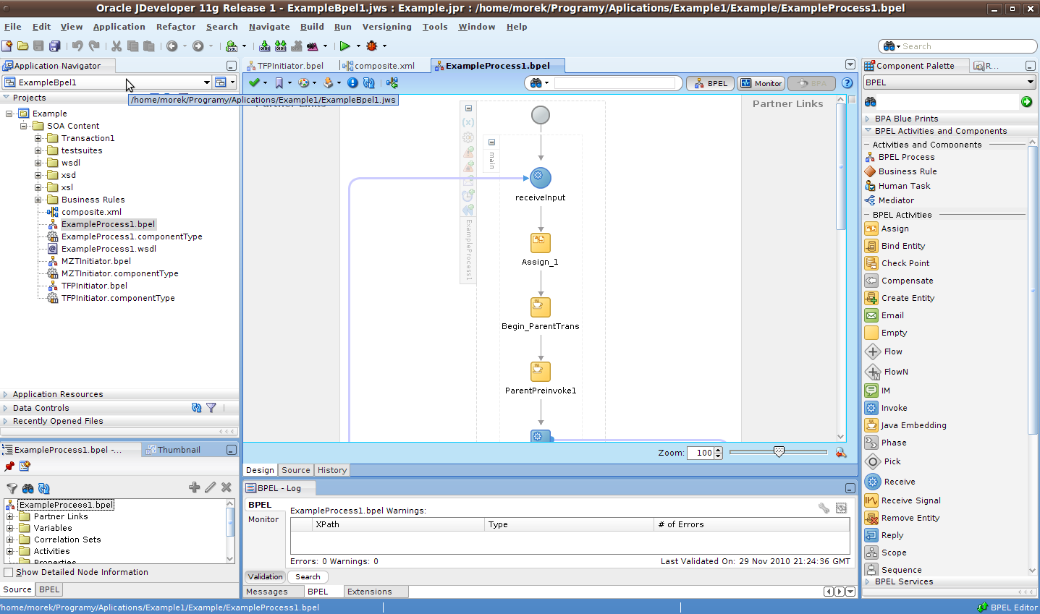
Jak to robili pradawni

Slide 34
Persystentny Multi-Listener, czyli... Saga?
Persystentny multi-listener... jak to pięknie brzmi...:)

Slide 35
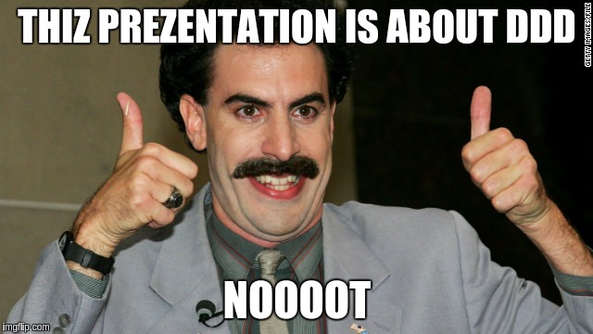

Slide 36
Po raz kolejny krok po kroku
Odbiorca
SM-SR
Evt
PrepareSMSRChange
(EID, currentSmsrId)

Slide 37
Po raz kolejny krok po kroku
Odbiorca
SM-SR
Saga manager
Evt
PrepareSMSRChange
(EID, currentSmsrId)

Slide 38
Po raz kolejny krok po kroku
Odbiorca
SM-SR
Saga manager
findOrCreate(EID)
SmsrChangeReceiverSaga
Evt
PrepareSMSRChange
(EID, currentSmsrId)

Slide 39
Po raz kolejny krok po kroku
Odbiorca
SM-SR
Saga manager
findOrCreate(EID)
SmsrChangeReceiverSaga
Evt
PrepareSMSRChange
(EID, currentSmsrId)
handlePrepareSMSRChange(…)

Slide 40
Po raz kolejny krok po kroku
Odbiorca
SM-SR
Saga manager
findOrCreate(EID)
SmsrChangeReceiverSaga
Evt
PrepareSMSRChange
(EID, currentSmsrId)
handlePrepareSMSRChange(…)
ScheduleSmsrChangeTimeout(EID)
Cmd
SendPrepareSmsrChangeResponse

Slide 41
Po raz kolejny krok po kroku
Odbiorca
SM-SR
Saga manager
findOrCreate(EID)
SmsrChangeReceiverSaga
Evt
PrepareSMSRChange
(EID, currentSmsrId)
handlePrepareSMSRChange(…)
ScheduleSmsrChangeTimeout(EID)
Cmd
SendPrepareSmsrChangeResponse
PrepareSMSRChangeResponse
ResponseSender

Slide 42
Po raz kolejny krok po kroku
Odbiorca
SM-SR
Saga manager
findOrCreate(EID)
SmsrChangeReceiverSaga
Evt
PrepareSMSRChange
(EID, currentSmsrId)
handlePrepareSMSRChange(…)
ScheduleSmsrChangeTimeout(EID)
Cmd
persist()
SendPrepareSmsrChangeResponse
PrepareSMSRChangeResponse
ResponseSender

Slide 43
Po raz kolejny krok po kroku
Odbiorca
SM-SR
Saga manager
findOrCreate(EID)
SmsrChangeReceiverSaga
Evt
PrepareSMSRChange
(EID, currentSmsrId)
handlePrepareSMSRChange(…)
Cmd
persist()
SendPrepareSmsrChangeResponse
PrepareSMSRChangeResponse
ResponseSender

Slide 44
Po raz kolejny krok po kroku
Odbiorca
SM-SR
Evt
HandoverEUICC
(EID, EIS)

Slide 45
Po raz kolejny krok po kroku
Odbiorca
Saga manager
SM-SR
findOrCreate(EID)
SmsrChangeReceiverSaga
Evt
HandoverEUICC
(EID, EIS)
handleHandoverEUICC(…)

Slide 46
Po raz kolejny krok po kroku
Odbiorca
Saga manager
SM-SR
findOrCreate(EID)
SmsrChangeReceiverSaga
CertificateStore
KnownSmsrs
Evt
HandoverEUICC
(EID, EIS)
handleHandoverEUICC(…)
findSmsrCert()
persist()
findTargetSmsrAddress()

Slide 47
Po raz kolejny krok po kroku
Odbiorca
Saga manager
SM-SR
findOrCreate(EID)
SmsrChangeReceiverSaga
CertificateStore
KnownSmsrs
Evt
HandoverEUICC
(EID, EIS)
handleHandoverEUICC(…)
findSmsrCert()
findTargetSmsrAddress()
RequestSender
Cmd
AuthenticateSmsrRequest
SendAuthenticateSmsrRequest
(EID, CERT.SR.ECDSA, address)

Slide 48
Po raz kolejny krok po kroku
Odbiorca
Saga manager
SM-SR
findOrCreate(EID)
SmsrChangeReceiverSaga
CertificateStore
KnownSmsrs
Evt
HandoverEUICC
(EID, EIS)
handleHandoverEUICC(…)
findSmsrCert()
persist()
findTargetSmsrAddress()
RequestSender
Cmd
AuthenticateSmsrRequest
SendAuthenticateSmsrRequest
(EID, CERT.SR.ECDSA, address)

Slide 49
Po raz kolejny krok po kroku
Kolejne kroki analogicznie ;)

Slide 50
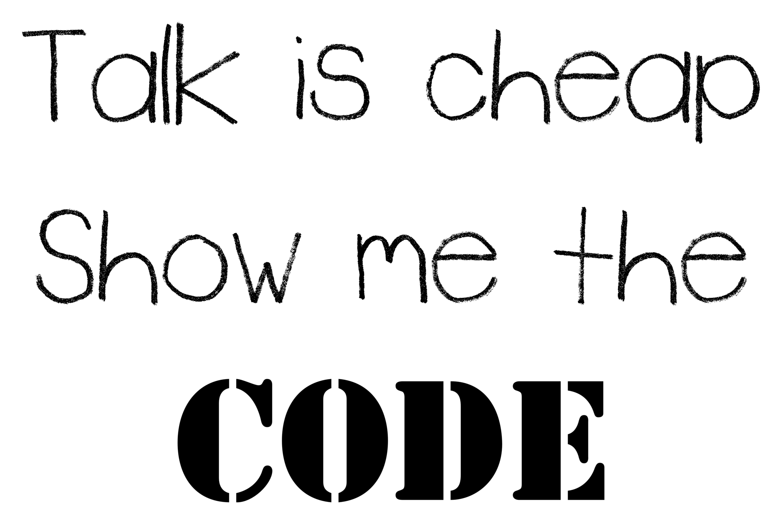

Slide 51
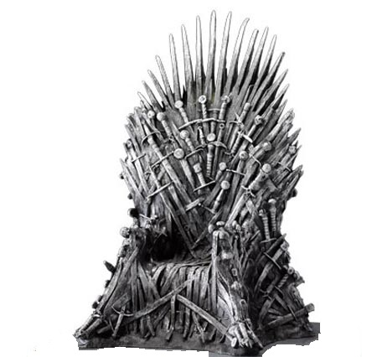

Przykład oparty na
Spring is coming
https://github.com/BottegaIT/ddd-leaven-v2
Nowsza implementacja
https://github.com/michal-michaluk/factory

Slide 52
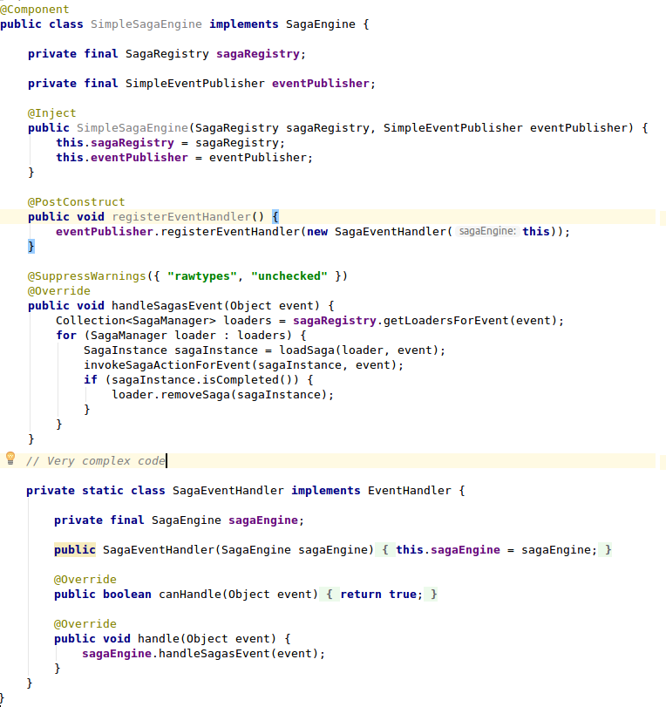
Spring is coming
Saga
Engine
Saga
Registry
Evt
getLoadersForEvent(event)
For each loader
Saga
Manager
loadSaga(event)
Saga
handle(event)

Slide 53
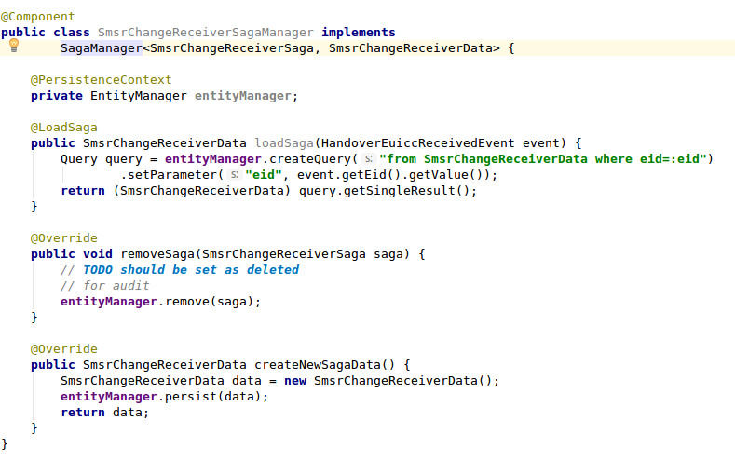
Spring is coming

Slide 54
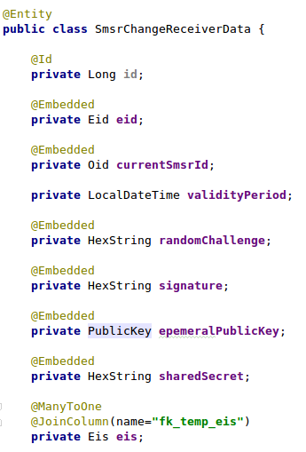
Spring is coming

Slide 55
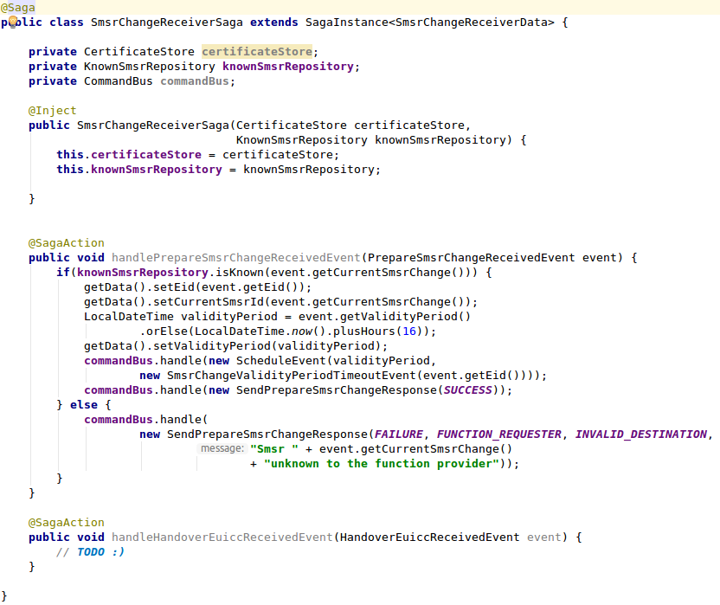
Spring …

Slide 56
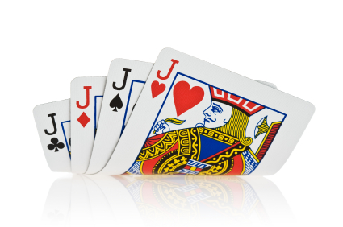
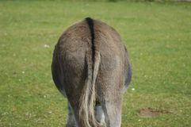
Spring is coming
Zady i walety
- Słabe skalowanie, wymaga rozwiązań w infrastrukturze
- Znana technologia
- Concurrent update, optimistic locking
- Utrudniony audyt
- Przywracanie po awarii

Slide 57

Microservice
Events
Events
BC1
BC3
Orders
Commands
Warehouse
Commands
Canonical
Model
Purchase Saga
Events
Events
BC2
BC4
Invoice
Commands
Customer
Commands

Slide 58

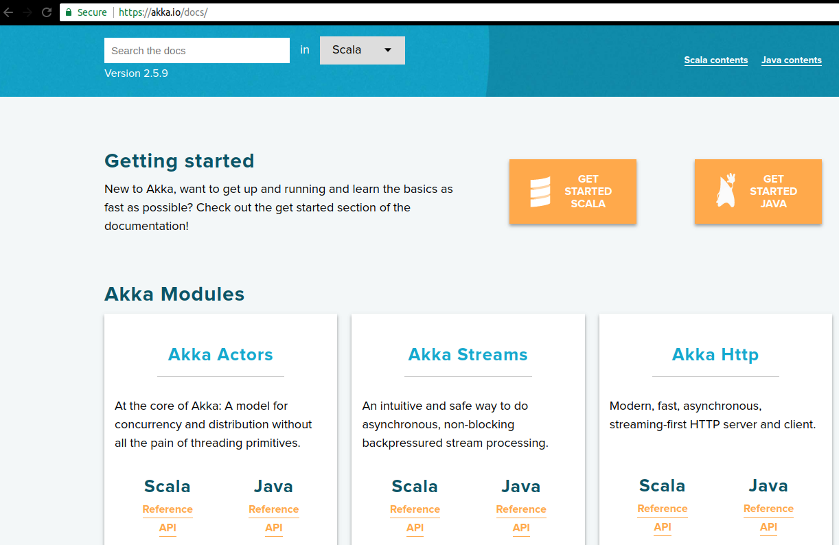
Zmiana podejścia

Slide 59
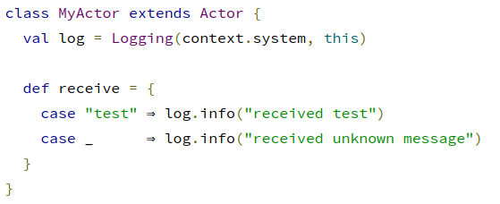
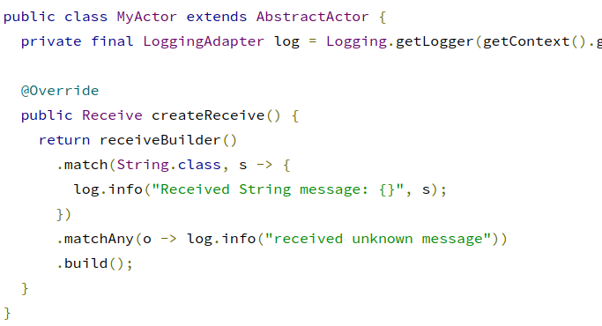
Actor model
Thread
Actor
Mailbox
MSG
2
MSG1
State
receive

Slide 60
Actor model
Thread0
Thread1
Rysiek z klanu
Ferdek Kiepski
Mailbox
receive
receive
Hello
kiepski ! „Hello”
kiepski.tell(„Hello”)

Slide 61
Actor model
Thread0
Thread1
Rysiek z klanu
Ferdek Kiepski
Mailbox
Hello
receive
receive

Slide 62
Actor model
Thread0
Thread1
Rysiek z klanu
Ferdek Kiepski
Mailbox
receive
receive
Hello
Idziemy pić
def receive = {
case str: String => sender ! „Idziemy pić”
case wtf => sender ! „Nie rozumiem”
}

Slide 63
Actor model
Thread0
Thread1
Rysiek z klanu
Ferdek Kiepski
Mailbox
Idziemy pić
receive
receive

Slide 64
Actor model
Thread0
Thread1
Rysiek z klanu
Ferdek Kiepski
Mailbox
receive
receive
Idziemy pić

Slide 65
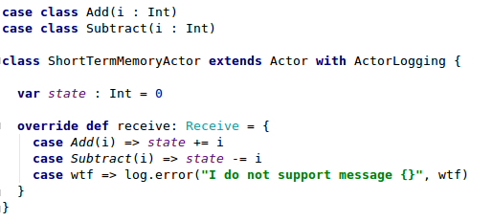
Actor model
Thread
Actor
Mailbox
Add
2
Sub
5
state
receive

Slide 66
Actor model
Thread
0
Add
2
Thread
Thread
1
Actor
Add
50
Mailbox
Add
2
Sub
5
state
Sub
2
receive
Thread
n

Slide 67
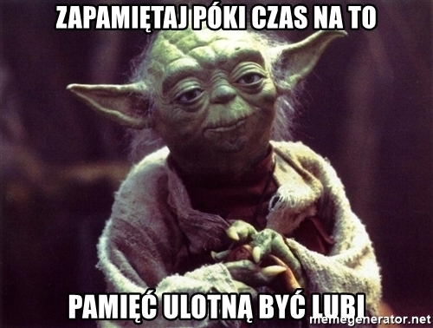
Actor model

Slide 68
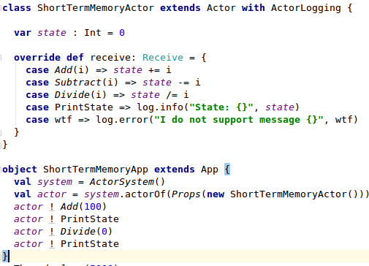
Actor model
Thread
Actor
Mailbox
Add
2
Sub
5
state
receive

Slide 69
Actor model
[INFO] [akka://default/user/$a] State: 100
[ERROR] [akka://default/user/$a] / by zero
java.lang.ArithmeticException: / by zero
at ShortTermMemoryActor$$anonfun$receive$1.applyOrElse(ShortTermMemoryActor.scala:15)
at akka.actor.Actor$class.aroundReceive(Actor.scala:484)
at ShortTermMemoryActor.aroundReceive(ShortTermMemoryActor.scala:8)
at akka.actor.ActorCell.receiveMessage(ActorCell.scala:526)
at akka.actor.ActorCell.invoke(ActorCell.scala:495)
at akka.dispatch.Mailbox.processMailbox(Mailbox.scala:257)
at akka.dispatch.Mailbox.run(Mailbox.scala:224)
at akka.dispatch.Mailbox.exec(Mailbox.scala:234)
at scala.concurrent.forkjoin.ForkJoinTask.doExec(ForkJoinTask.java:260)
at scala.concurrent.forkjoin.ForkJoinPool$WorkQueue.runTask(ForkJoinPool.java:1339)
at scala.concurrent.forkjoin.ForkJoinPool.runWorker(ForkJoinPool.java:1979)
at scala.concurrent.forkjoin.ForkJoinWorkerThread.run(ForkJoinWorkerThread.java:107)
[INFO] [akka://default/user/$a] State: 0

Slide 70
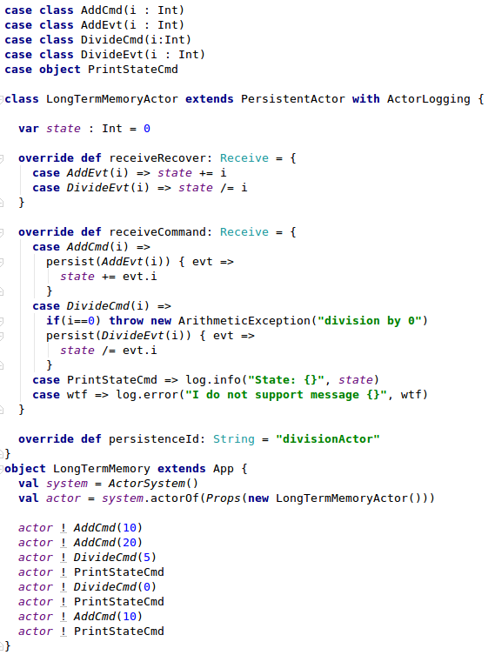
Actor model
Thread
PersistentActor
Mailbox
Add
2
Sub
5
state
receiveCommand

Slide 71
Actor model
[INFO] [akka://default/user/$a] State: 6
[ERROR] [akka://default/user/$a] division by 0
java.lang.ArithmeticException: division by 0
at LongTermMemoryActor$$anonfun$receiveCommand$1.applyOrElse(LongTermMemoryActor.scala:26)
at akka.actor.Actor$class.aroundReceive(Actor.scala:484)
at akka.persistence.Eventsourced$$anon$1.stateReceive(Eventsourced.scala:662)
at akka.persistence.Eventsourced$class.aroundReceive(Eventsourced.scala:183)
at LongTermMemoryActor.aroundReceive(LongTermMemoryActor.scala:11)
….
[INFO [akka://default/user/$a] State: 6
[INFO] [akka://default/user/$a] State: 16

Slide 72
Actor model
Thread
PersistentActor
Mailbox
State = 0
receiveCommand
Stream

Slide 73
Actor model
Thread
PersistentActor
Mailbox
Add
6
State = 0
receiveCommand
Stream

Slide 74
Actor model
Thread
PersistentActor
Mailbox
State = 0
case AddCmd(i) =>
persist(AddEvt(i))
receiveCommand
Add
6
AddEvt(6)
Stream

Slide 75
Actor model
Thread
PersistentActor
Mailbox
State = 6
case AddCmd(i) =>
persist(AddEvt(i)) { evt =>
state += evt.i
}
receiveCommand
AddEvt(6)
Stream

Slide 76
Actor model
Thread
PersistentActor
Mailbox
Add
10
State = 6
receiveCommand
AddEvt(6)
Stream

Slide 77
Actor model
Thread
PersistentActor
Mailbox
State = 6
receiveCommand
Add
10
AddEvt(10)
AddEvt(6)
Stream

Slide 78
Actor model
Thread
PersistentActor
Mailbox
State = 16
receiveCommand
AddEvt(10)
AddEvt(6)
Stream

Slide 79
Actor model
Thread
PersistentActor
Mailbox
Div
0
State = 16
receiveCommand
AddEvt(10)
AddEvt(6)
Stream

Slide 80
Actor model
Thread
PersistentActor
Mailbox
State = 16
receiveCommand
Div
0
AddEvt(10)
AddEvt(6)
Stream

Slide 81
Actor model
Thread
PersistentActor
Mailbox
State = 0
receiveRecover
AddEvt(10)
override def receiveRecover: Receive = {
case AddEvt(i) => state += i
case DivideEvt(i) => state /= i
}
AddEvt(6)
Stream

Slide 82
Actor model
Thread
PersistentActor
Mailbox
State = 6
receiveRecover
AddEvt(10)
AddEvt(6)
Stream

Slide 83
Actor model
Thread
PersistentActor
Mailbox
State = 16
receiveRecover
AddEvt(10)
AddEvt(6)
Stream

Slide 84

Actor model
TOO MUCH EVENTS

Slide 85
Actor model
Thread
PersistentActor
AddEvt(12)
Mailbox
State(100)
state = 112
DivEvt(54)
receiveRecover
x 1000
AddEvt(10)
AddEvt(6)
Stream

Slide 86
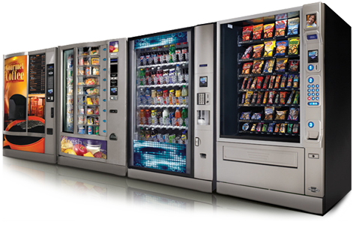
Actor model
Maszyna stanu… czyli akka FSM

Slide 87
Actor model
Zady i walety
Inne podejście do projektowania aplikacji
Brak magicznie działających technologii (np. MDC traci rację bytu)
Nie działają adnotacje… bo nie ma kontenera
Wszystko musi być immutable
Enkapsulacja level PRO
Thread safe (optimistic/pesimistic locking nie są potrzebne)
Audyt za darmo, łatwo odtworzyć kolejne kroki
Dobry kandydat zarówno na Sagę jak i na Encję
Naturalne wsparcie dla maszyny stanu

Slide 88

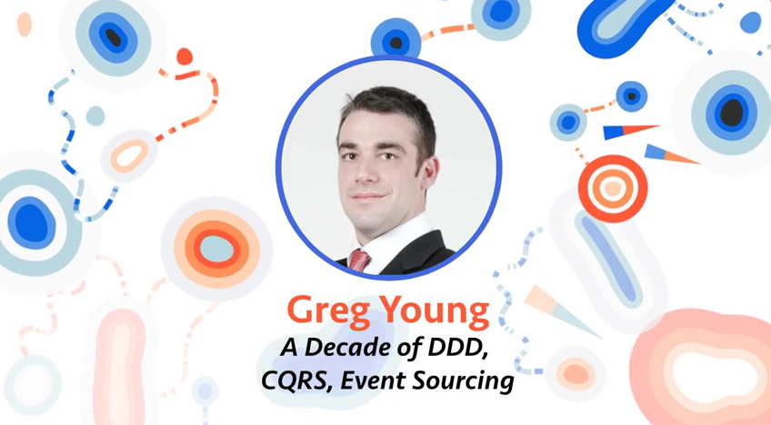
Trochę odlecimy
https://www.youtube.com/watch?v=LDW0QWie21s
https://www.youtube.com/watch?v=8JKjvY4etTY
https://www.youtube.com/watch?v=JHGkaShoyNs

Slide 89
Klasyk DDD
Bounded Context (SMSR)
EIS
Aggregate Root
ECASD
EIS
Aggregate
ECASD
ORM
ISDR
ISD-R
ISDP
ISD-P

Slide 90
Odjechane DDD
Bounded Context (SMSR)
Aggregate Root
EIS
Aggregate
ECASD
ISDR
ISDP

Slide 91

Aktor w chmurze

Slide 92
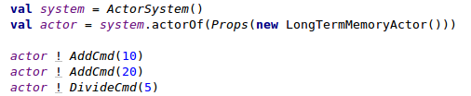
Actor model
Aktor jest anonimowy
() => Props(LongTermMemoryActor())

Slide 93
Actor model
PrepareSmsrChange
(EID=15, currentSmsrId)
cloud
RoundRobin
EID(1..10)
EID(11..20)
EID(21…30)
Node1
Node2
Node3
Akka cluster

Slide 94
Actor model
val saga: ActorRef = ClusterSharding(system).start(
typeName = „SmsrChangeReceiverSaga",
entityProps = Props[SmsrChangeReceiverSaga],
settings = ClusterShardingSettings(system),
extractEntityId = extractEntityId,
extractShardId = extractShardId
)
PrepareSmsrChange
(EID, currentSmsrId)
val extractEntityId: ShardRegion.ExtractEntityId = {
case PrepareSmsrChange(eid,_)=>
eid.value
}
Node1
val extractShardId: ShardRegion.ExtractShardId = {
case PrepareSmsrChange(eid,_)=>
(BigInt(eid) % numberOfShards).toString
}

Slide 95
Actor model
PrepareSmsrChange
(EID=15, currentSmsrId)
cloud
RoundRobin
EID(1..10)
EID(11..20)
EID(21…30)
Node1
Node2
Node3
Akka cluster

Slide 96
Actor model
To się skaluje
PrepareSmsrChange
(EID, currentSmsrId)
cloud
RoundRobin
Node1
Node2
Node3
Node4
Node5
Akka cluster

Slide 97
Actor model
Ale aż tak super nie jest
Shard Coordinator Actor
Shard Region
Actor
cloud
Node1
Node2
Node3
Akka cluster

Slide 98
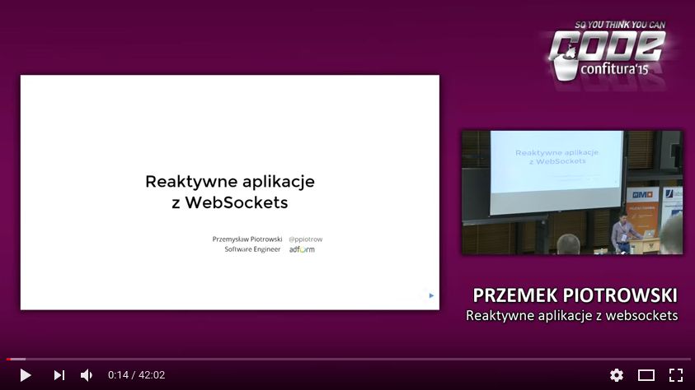
Inny ciekawy przykład
https://www.youtube.com/watch?v=qP2A6DODr98

Slide 99
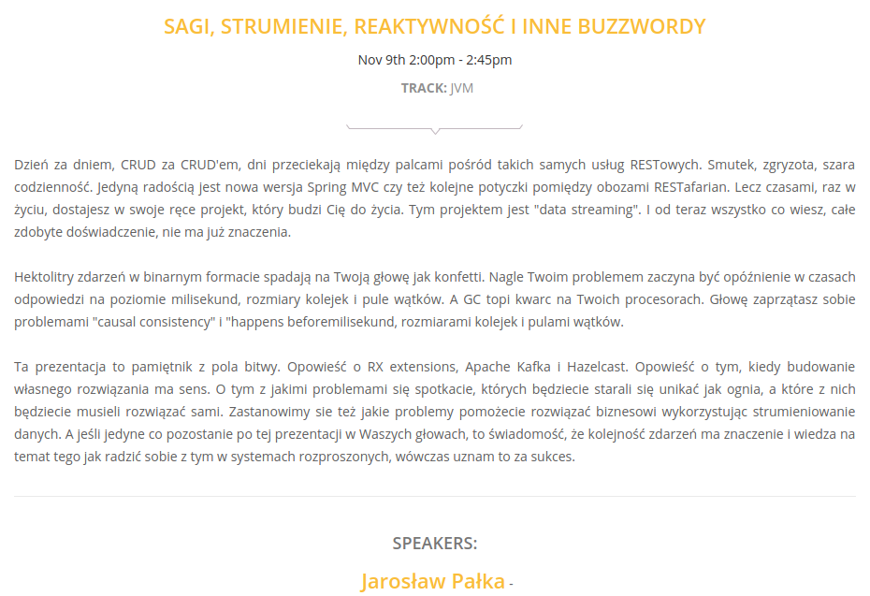
Jeszcze ciekawsze zastosowanie

Slide 100
Pytania?

Slide 101
Damian Sińczak
Scala Developer
Włodars Padawan
damian.sinczak@gmail.com
https://www.linkedin.com/in/dsinczak
https://twitter.com/dsinczak

